Slide 1
Machine Learning and Modeling Techniques– logistic Regression
Cuny LaGUardia community college

Slide 2

What is logistic regression?
Unlike actual regression, logistic regression does not try to predict the value of a numeric variable given a set of inputs. Instead, the output is a probability that the given input point belongs to a certain class.
The output of Logistic Regression always lies in [0, 1].

Slide 3
What is logistic regression?
Logistic Regression is used as a method for Classification.
Some examples of classification problems include:
Spam vs not spam
Has disease or not
Customer participation
These are examples of a binary classification

Slide 4
What is logistic regression?
We previously looked at linear regression – which is used to solve problems that deal with values on a continuous scale
Logistic regression allows us to solve classification problems, where we want to predict discrete categories (yes/no, 1/0, etc.)

Slide 5
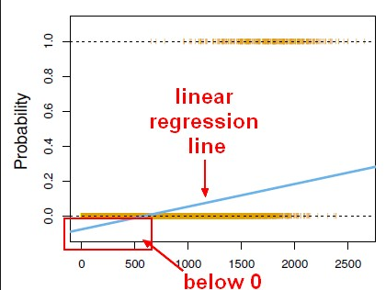
logistic regression
For certain problems, such as classification, linear regression models wont lead to a good fit on the data.

Slide 6
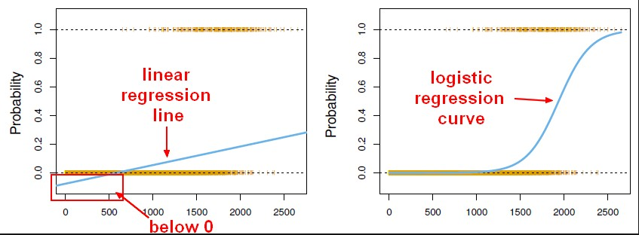
logistic regression
Instead, we use the logistic regression model:

Slide 7
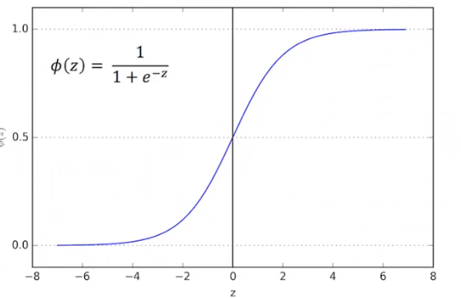
logistic regression
Logistic regression takes in any value and outputs it between 0 and 1 – which corresponds to a classification prediction – yes/no, etc.

Slide 8
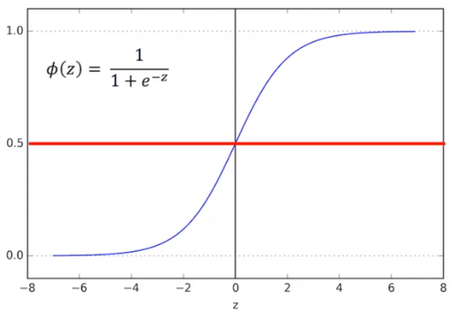
logistic regression
Logistic regression takes in any value and outputs it between 0 and 1 – which corresponds to a classification prediction – yes/no, etc.

Slide 9
Logistic regression
In model development, generally you first train your model on ‘training data’. After your model has been trained, you test, or evaluate your model’s performance on some ‘testing’ data.
In logistic regression, you can evaluate how well your model performed by using something known as a ‘confusion matrix’.

Slide 10
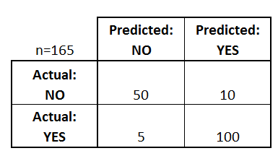
Confusion matrix dataschool.io
A confusion matrix is a table that is often used to describe the performance of a classification model (or "classifier") on a set of test data for which the true values are known.
What can we learn from this matrix?

Slide 11
Confusion matrix dataschool.io
There are two possible predicted classes: "yes" and "no". If we were predicting the presence of a disease, for example, "yes" would mean they have the disease, and "no" would mean they don't have the disease.
The classifier made a total of 165 predictions (e.g., 165 patients were being tested for the presence of that disease).
Out of those 165 cases, the classifier predicted "yes" 110 times, and "no" 55 times.
In reality, 105 patients in the sample have the disease, and 60 patients do not.

Slide 12
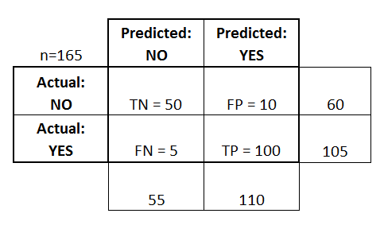
Confusion matrix dataschool.io
true positives (TP): These are cases in which we predicted yes (they have the disease), and they do have the disease.
true negatives (TN): We predicted no, and they don't have the disease.
false positives (FP): We predicted yes, but they don't actually have the disease. (Also known as a "Type I error.")
false negatives (FN): We predicted no, but they actually do have the disease. (Also known as a "Type II error.")

Slide 13
Confusion matrix dataschool.io
Accuracy: Overall, how often is the classifier correct?
(TP+TN)/total = (100+50)/165 = 0.91
Misclassification Rate: Overall, how often is it wrong?
(FP+FN)/total = (10+5)/165 = 0.09
equivalent to 1 minus Accuracy
also known as "Error Rate"
True Positive Rate: When it's actually yes, how often does it predict yes?
TP/actual yes = 100/105 = 0.95
also known as "Sensitivity" or "Recall"
False Positive Rate: When it's actually no, how often does it predict yes?
FP/actual no = 10/60 = 0.17
True Negative Rate: When it's actually no, how often does it predict no?
TN/actual no = 50/60 = 0.83
equivalent to 1 minus False Positive Rate
also known as "Specificity"

Slide 14
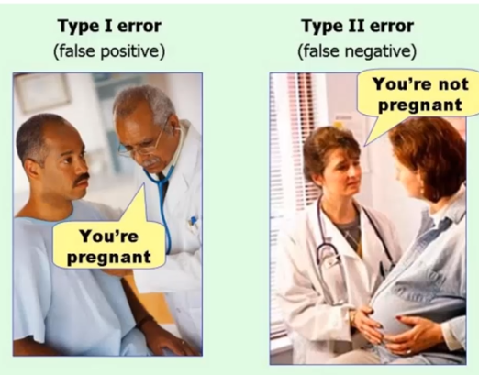
Confusion matrix

Slide 15
Logistic regression
https://www.youtube.com/watch?v=7qJ7GksOXoA

Slide 16
Break – 15mins

Slide 17
Logistic regression
Lets work on creating a logistic model using test and train data.
We’ll use a dataset from Kaggle.com - we’ll try to predict if a passenger on the titanic is likely to survive.

Slide 18
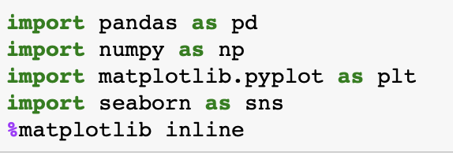
Kaggle dataset – titanic
Lets start our analysis by importing our necessary libraries

Slide 19
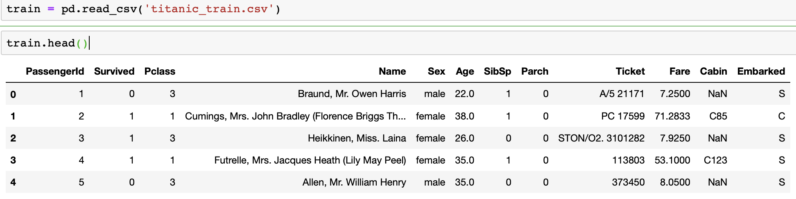
Kaggle dataset – titanic
Let's start by reading in the titanic_train.csv file into a pandas dataframe.

Slide 20
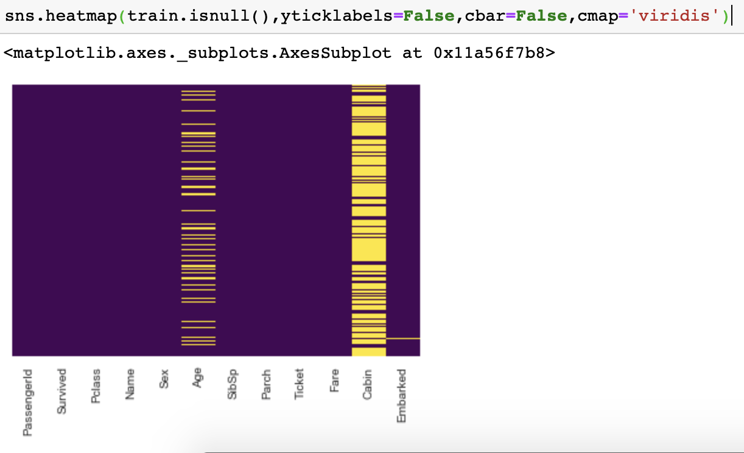
Missing data
We can use seaborn to create a map of missing data within the dataset.
What do you notice from this?

Slide 21
Missing data
Roughly 20 percent of the Age data is missing. The proportion of Age missing is likely small enough for reasonable replacement with some form of imputation.
Cabin column - looks like we are just missing too much of that data to do something useful with at a basic level.

Slide 22
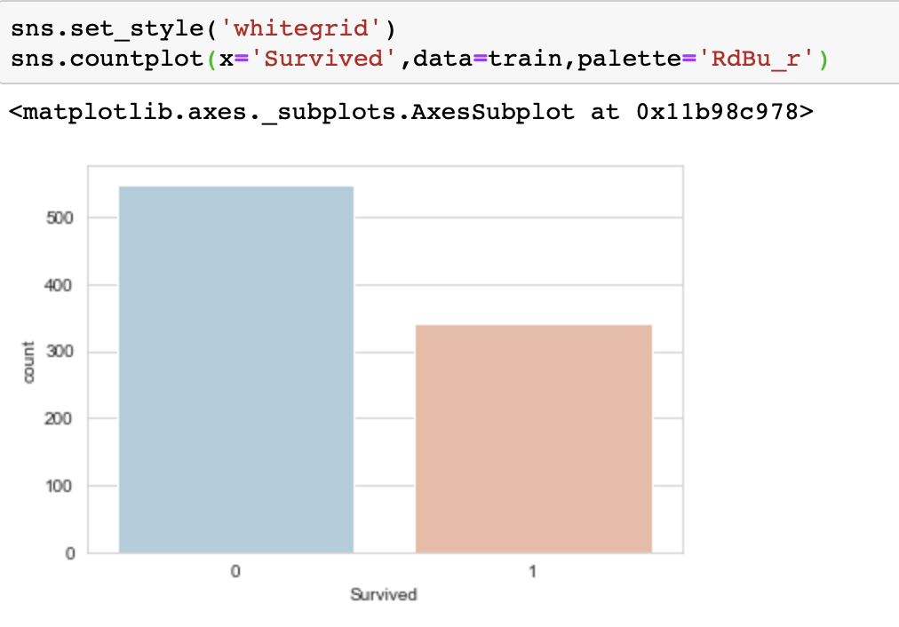
EDA
We can see that, based on the graph chart – more people were likely to …

Slide 23
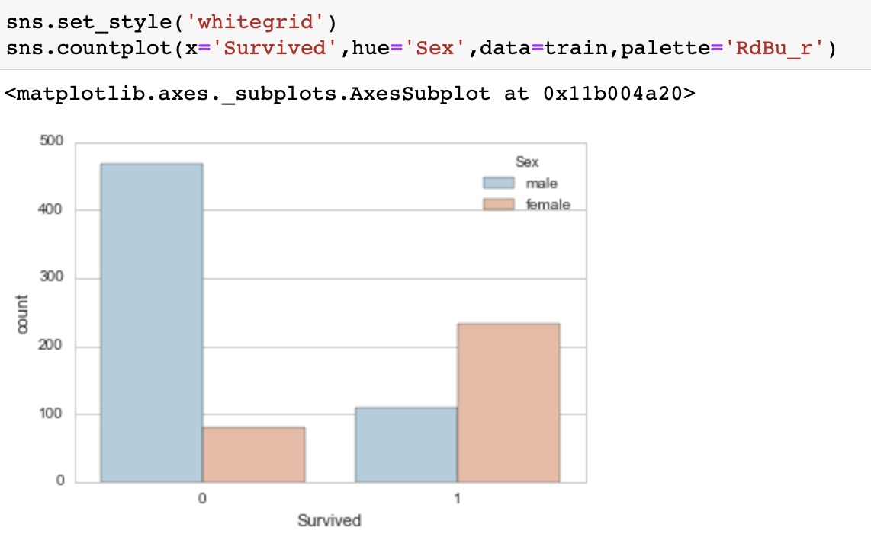
EDA
How did gender play a role in survival?

Slide 24
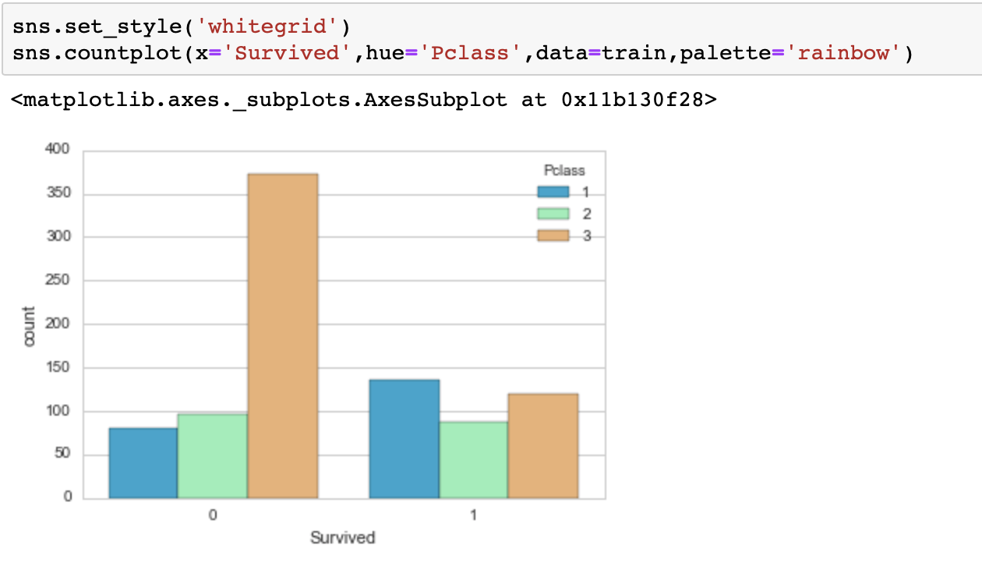
EDA
Class?

Slide 25
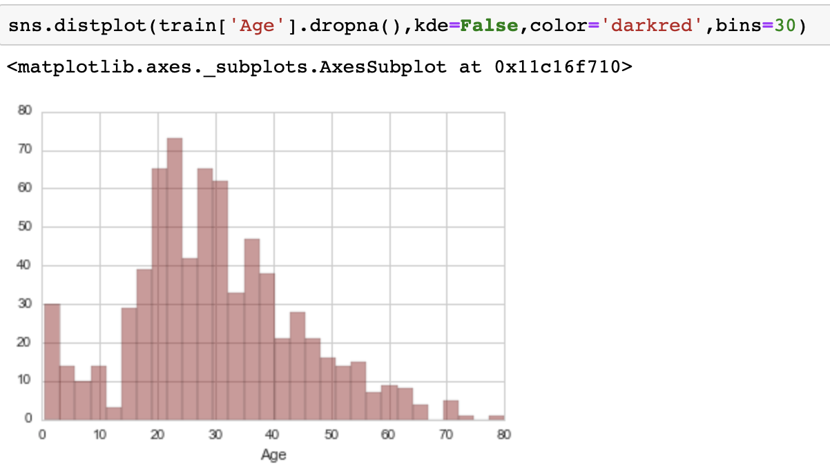
EDA
Age?

Slide 26
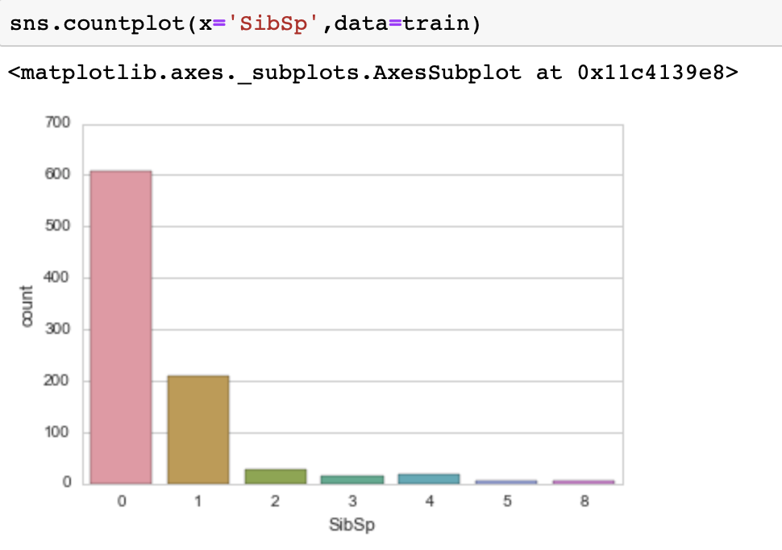
EDA
Siblings

Slide 27
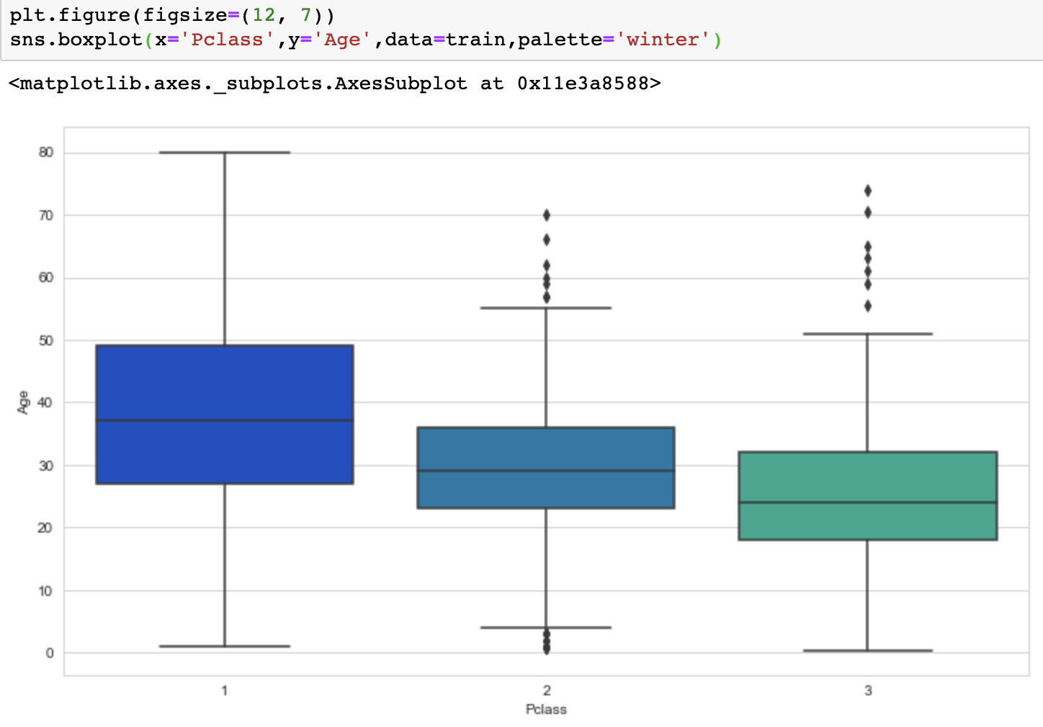
Data cleaning
Remember earlier we had some missing data …
We want to fill in missing age data instead of just dropping the missing age data rows. One way to do this is by filling in the mean age of all the passengers (imputation).
However we can be smarter about this and check the average age by passenger class. For example:

Slide 28
Data cleaning
However we can be smarter about this and check the average age by passenger class. For example:
We can see the wealthier passengers in the higher classes tend to be older, which makes sense. We'll use these average age values to impute based on Pclass for Age.

Slide 29
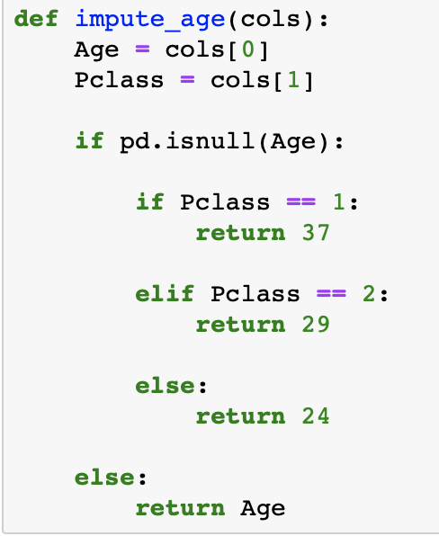
Data cleaning
Lets go through this code

Slide 30
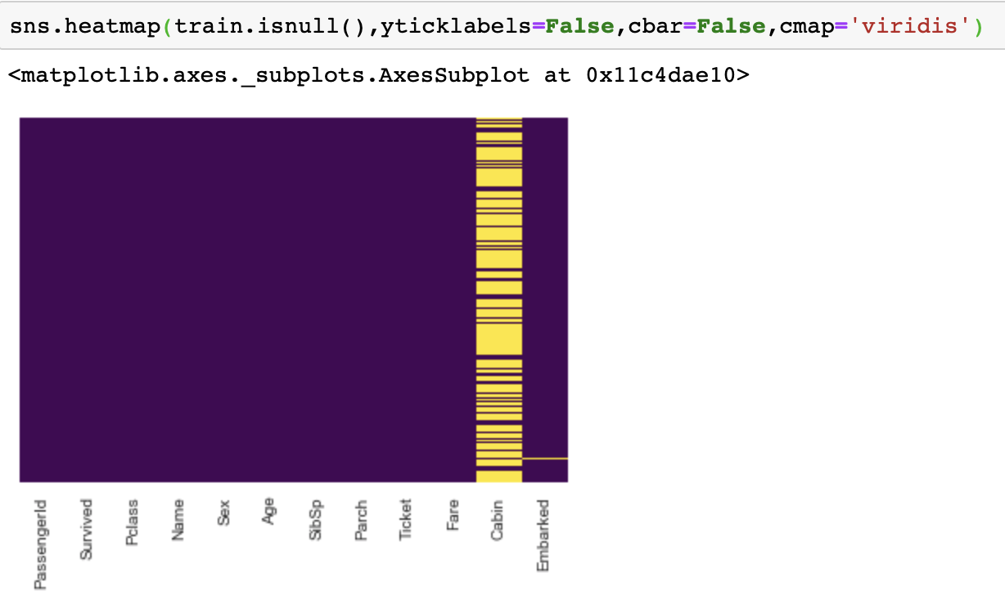
Data cleaning
Lets see our NA values again
Lets drop the cabin and other NAs

Slide 31

Data cleaning

Slide 32
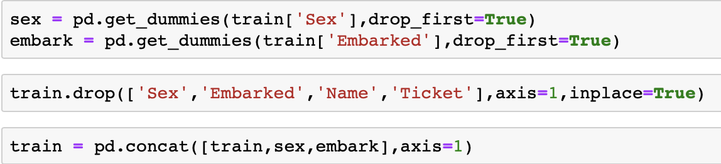
Data wrangling
In order for our logistic model to work, we need to convert all non-numeric variables to numeric and drop not needed columns,

Slide 33
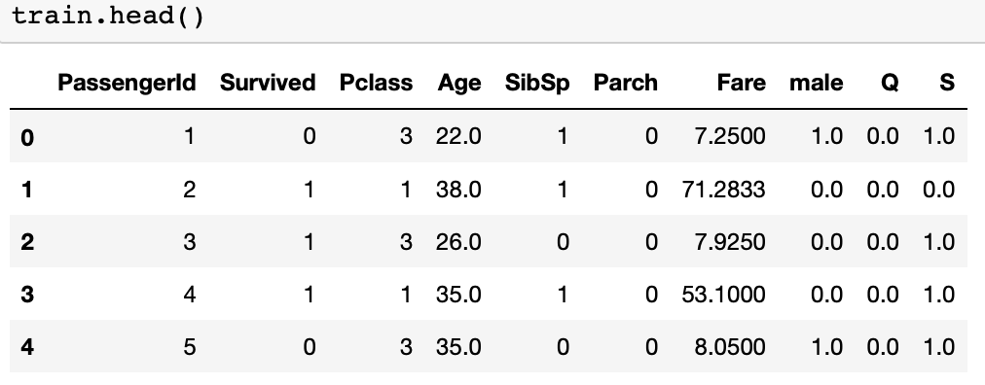
Data wrangling

Slide 34
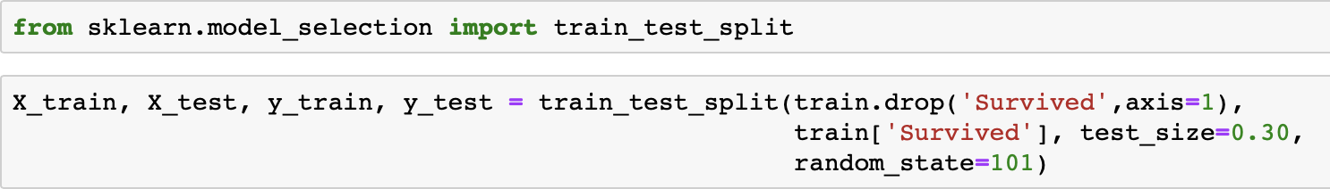
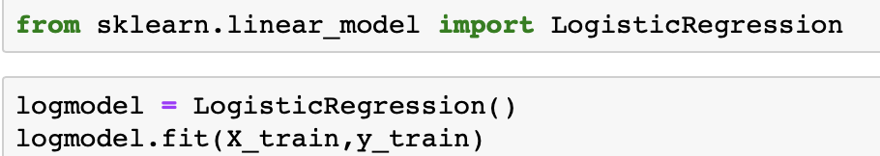
Logistic model
Let's start by splitting our data into a training set and test set
Train Test Split:
Training and Predicting

Slide 35
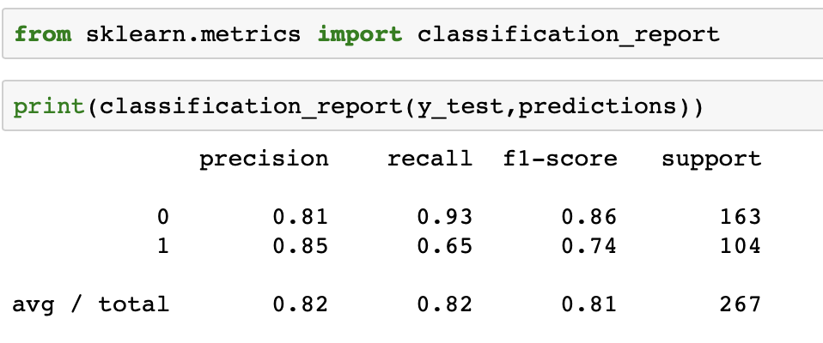
Evaluation
Check evaluation of our model:

Slide 36
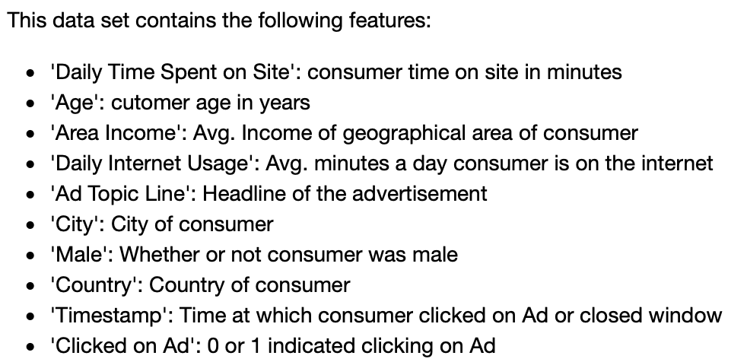
Your turn…
You will be working with a fake advertising data set, indicating whether or not a particular internet user clicked on an Advertisement.
We will try to create a model that will predict whether or not they will click on an ad based off the features of that user.

Slide 37
Your turn…
Download the logistic regression assignment and complete!

